Slide 1
Pizza sales SQL Project
Presented by Bibek kumar Patel

Slide 2
Preface
This project focuses on pizza sales analysis, showcased on a SQL platform. It demonstrates the utilization of aggregate functions, joins, Common Table Expressions (CTEs), and more to extract insights from the pizza database.

Slide 3


Retreving Total No of Order Placed

Slide 4
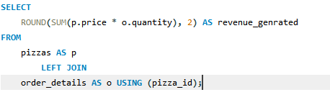

Calculate the total revenue generated from pizza sales.

Slide 5
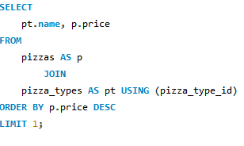

Identify the highest-priced pizza.

Slide 6
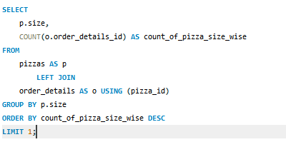

Identify the most common pizza size ordered

Slide 7
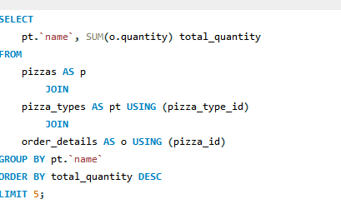
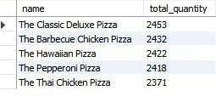
List the top 5 most ordered pizza types along with their quantities.

Slide 8
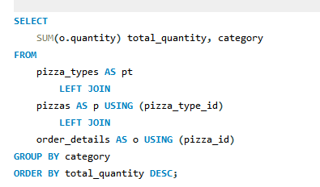
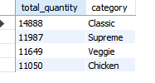
Join the necessary tables to find the total quantity of each pizza category ordered

Slide 9
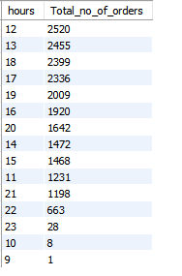
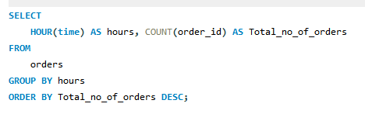
Determine the distribution of orders by hour of the day.

Slide 10
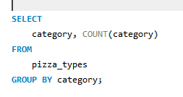

Join relevant tables to find the category-wise distribution of pizzas.

Slide 11
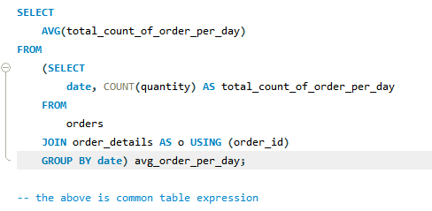
Group the orders by date and calculate the average number of pizzas ordered per day.

Slide 12

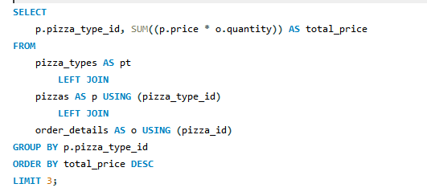

Determine the top most ordered pizza types based on revenue.

Slide 13
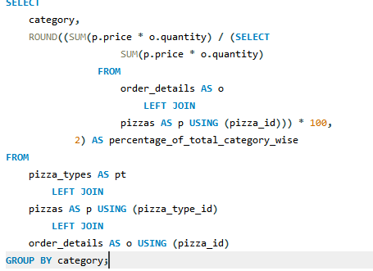

Calculate the percentage contribution of each pizza type to total revenue.

Slide 14


